Slide 1
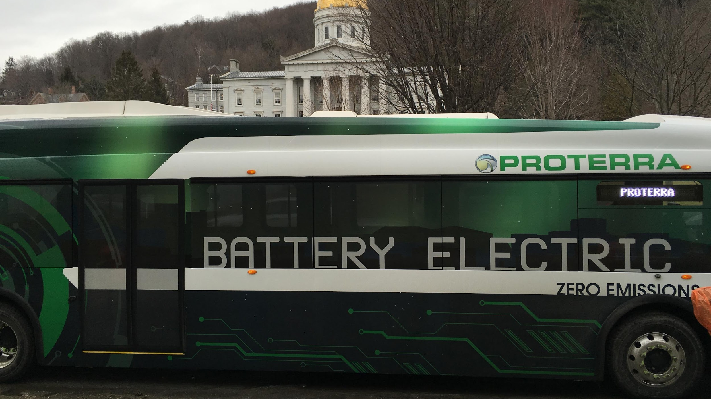
Future of Rural Transit
Project Overview

Slide 2
Vision
Prepare Vermont to have the most efficient, equitable, and cost-effective rural transportation system in the US

Slide 3
Project Goal
Expand transportation options for rural communities by offering combined bus services to schools and community members using electric buses.

Slide 4
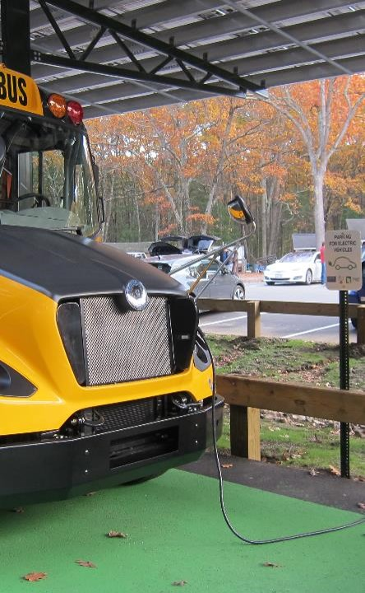
What’s Happened So Far
Researched models of combined service
  In Vermont and beyond
Recruited interested school districts
  Mount Mansfield Unified Union SU
  Orange East SU
Feasibility Study
  Combined service is legal
  Strong partnership needed among SU and transit agency

Slide 5
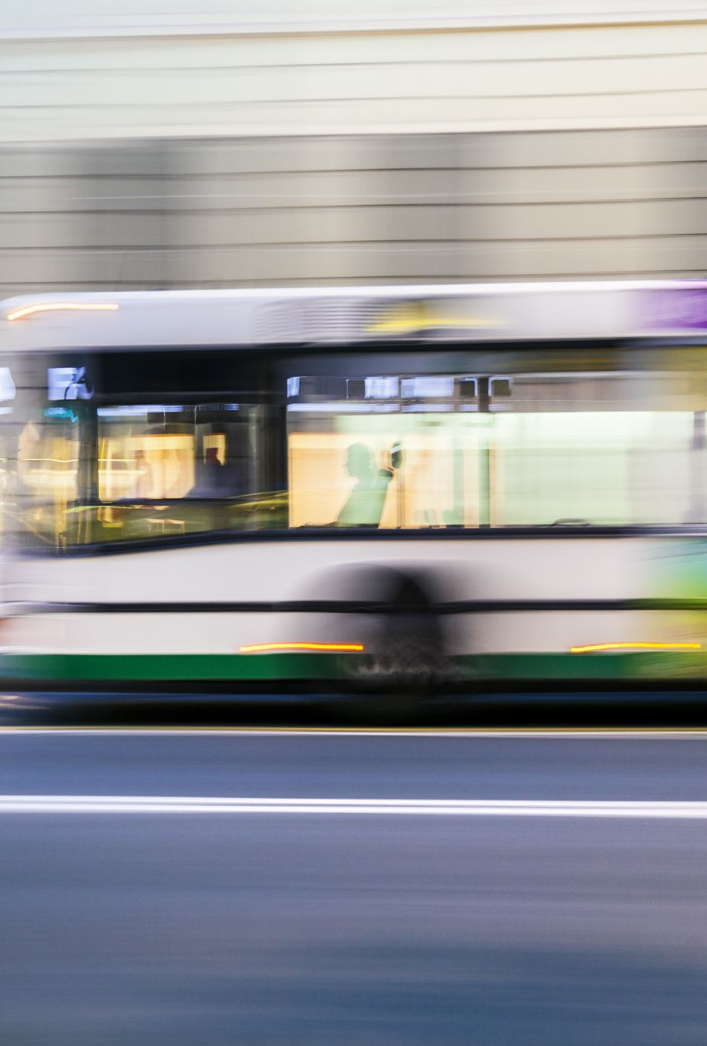
Findings
Students traveling to school on public transit can work
School transportation can’t always support equitable after school opportunities for students
Public transit could supplement school transportation services
Replacing school transportation routes w/public transit service is complicated
Students are an important market segment for public transit ridership
Education (climate/equity/economy) needed to increase student ridership on a school or transit bus

Slide 6
Successes and Challenges
Successes
Challenges
Interest among transit agencies (Tri Valley Transit)
VTrans can fund route amendments
Staffing challenges at schools and transit agencies (opportunity?)
New routes (or deviations) need ridership
Successful implementation will require champion(s)

Slide 7
Opportunities
75+ high schools within 3 miles of existing fixed route transit
Small deviations can increase opportunity for high school students
Serve communities with school choice
Serve tech centers with large catchment areas
Provide work-based learning opportunities with mid-day service
Strengthen transit with more ridership

Slide 8
Value Proposition(s)
1. Transit providers
  Increase ridership
  create life-long transit riders
2. School districts
    Increase student (and staff) mobility and access to activities
    Potential to save money
    Reduce number/length of school bus routes
3. Towns
  Reduce school transportation budgets
  Increase transit access for everyone
4. Students and parents
  Increased transportation options and independence for students
Notes:
More students ride the bus?
Increased safety from fewer students driving to school

Slide 9
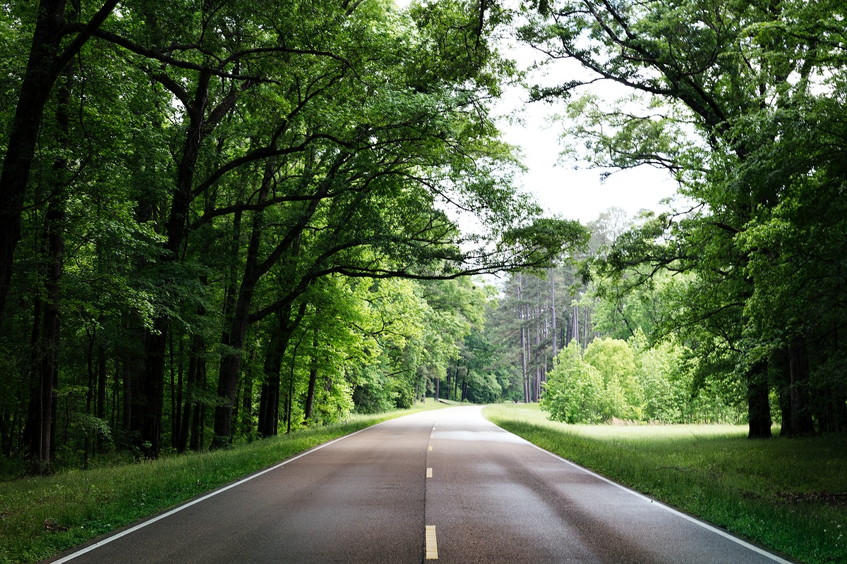
Questions and Discussion
Initial thoughts?
Anything we missed?
Good candidates or communities with high need for combined service?
What are the school transportation challenges in your region?
Where are the opportunities for emissions reductions?

Slide 10
Appendix

Slide 11
Program Partners
Steering committee:
  Jennifer Wallace-Brodeur (VEIC)
  Cara Robechek (EAN)
  Linda McGinnis (EAN)
  Peggy O’Neill-Vivanco (VT CCC)
  Chris Damiani (Green Mountain Transit)
  Dan Currier and Ross McDonald (AOT/Go VT)
  Mariah Keagy (VEEP)
Advisory committee includes individuals from: GMP, AARP, VCIL, Vital Communities, VNRC, VSA, VBSR, VPPSA, DPS, WCSU, TRORC, NWRPC

Slide 12
Feasibility Study

Slide 13
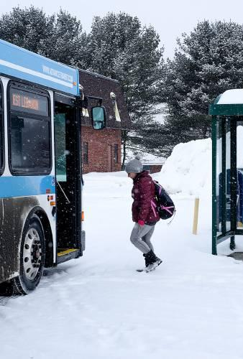
Mount Mansfield United Unified School District
Transit partner: GMT
Focus on supplemental service: after school
  - Students’ extra curricular participation is limited by school bus schedule
Richmond scoping study underway with GMT
  - Consider students as riders
Limited capacity at GMT to consider route expansion

Slide 14
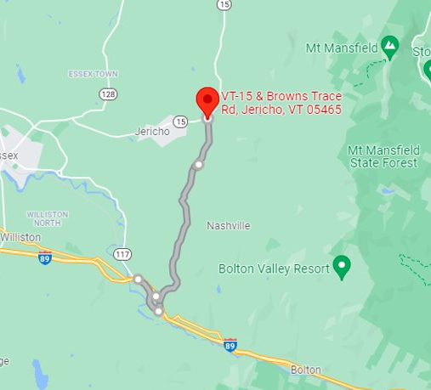
MMUUSD Proposed Route
Along Rt 2 in downtown Richmond
Serve:
  Riverview Commons Manufactured Housing Community
  Camel’s Hump Middle School
  MMU
Could be electrified

Slide 15
Take-aways
GMT has limited capacity to increase service
Difficult to staff during peak hours (after school)
Long deadhead trips from GMT garage in Burlington
Our survey revealed that a third of respondents are interested in combined service in the MMUUSD
Would additional stops aid in afterschool participation? | # Respondents​
Yes​ | 25​
No​ | 44​

Slide 16
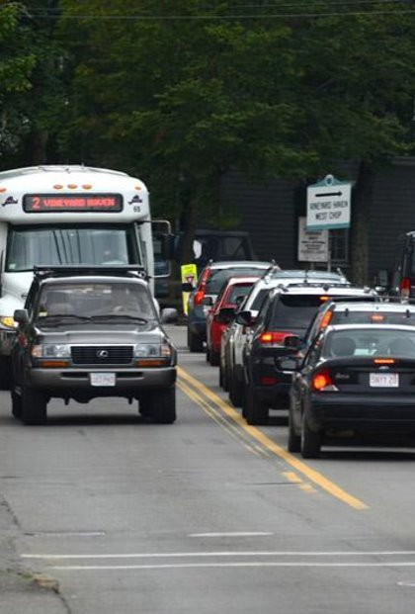
OESU
Transit partner: Tri Valley Transit
Focus on bringing students to activities off campus and employment in village centers and shoppes
Small deviations in existing route could serve two high schools and the Bradford Tech Center
TVT has a strong interest in collaborating
  - Already providing transportation to Sharon Academy

Slide 17
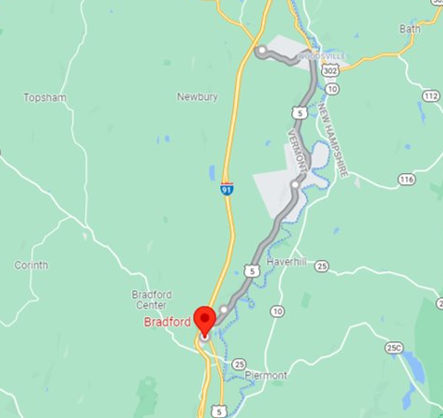
Orange East Proposed Route
Run along Rt 5
Could Serve
  Bradford Tech Center
  Blue Mountain HS
  Newbury Village
  Ox Box High School
Small deviations from existing River Route
Could be electrified

